Slide 1
Aviation Risk Analysis
insights from NTSB Data (1962-2023)
Charity P Mwangangi

Slide 2
Introduction
This project uses NTSB aviation accident data as from 1962-2023
It analyzes fatal injuries associated with aircraft model, category and engine type
The goal is to advise the company on the safer investment choice in aviation

Slide 3
Problem Statement
What aircraft models or engine type pose highest fatal injuries
Which categories show more fatal injuries
We aim to make recommendations based on the data to reduce aviation injuries

Slide 4
Data source and Tools used
Data: NTSB Aviation Accident Database
Tools-python
-Jupyter Notebook
-Pandas ,NumPy
-matplotlib

Slide 5
Data cleaning
Removed missing and irrelevant entries
Filled empty rows with mode and unknown and nan
Prepared columns for analysis (Model, category, engine type)

Slide 6
Key Area of analysis
Fatal injuries grouped by:
Aircraft model
Category(e.g. helicopter, airplane)
Engine type (e.g., turbojet)

Slide 7
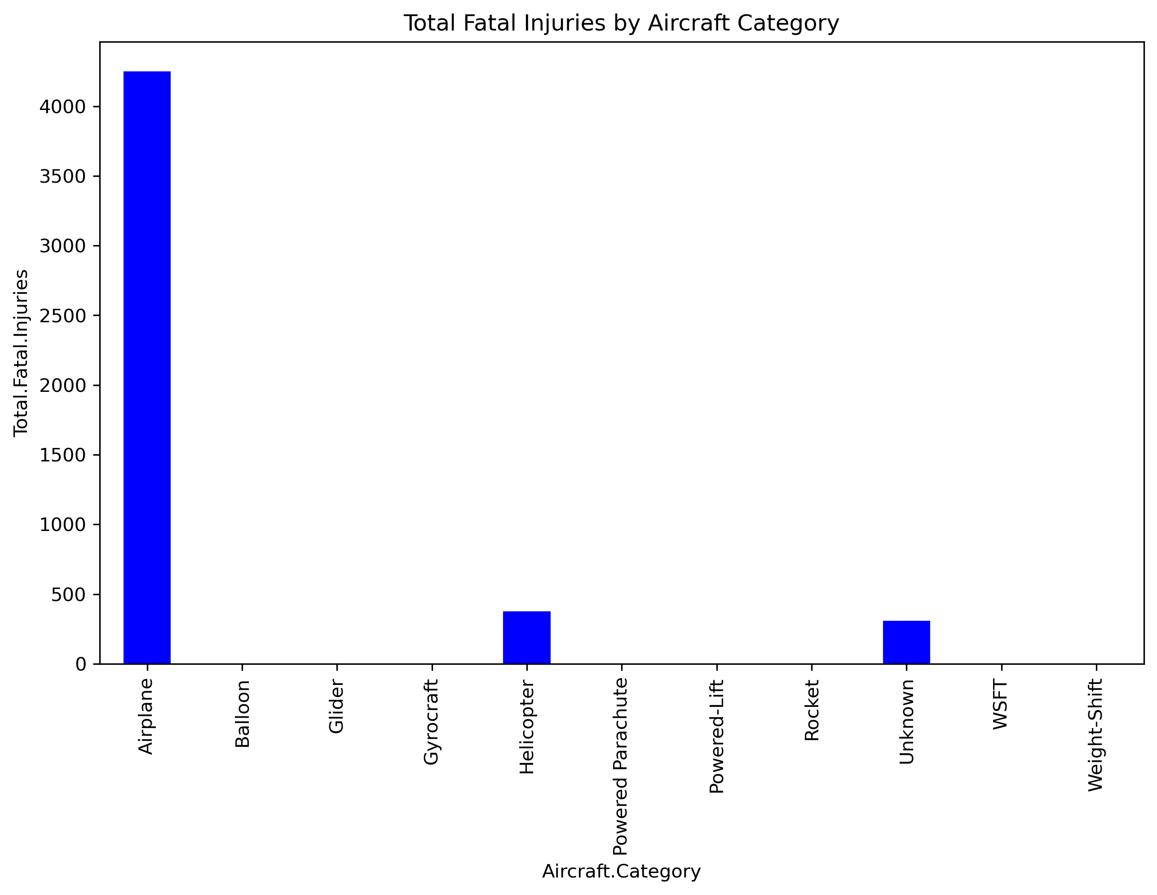
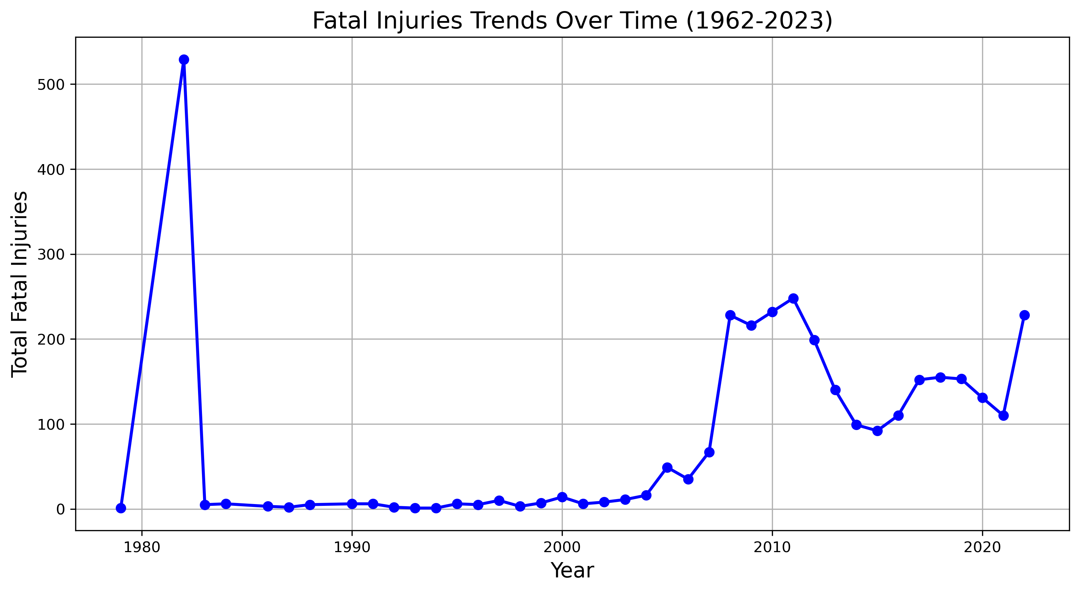
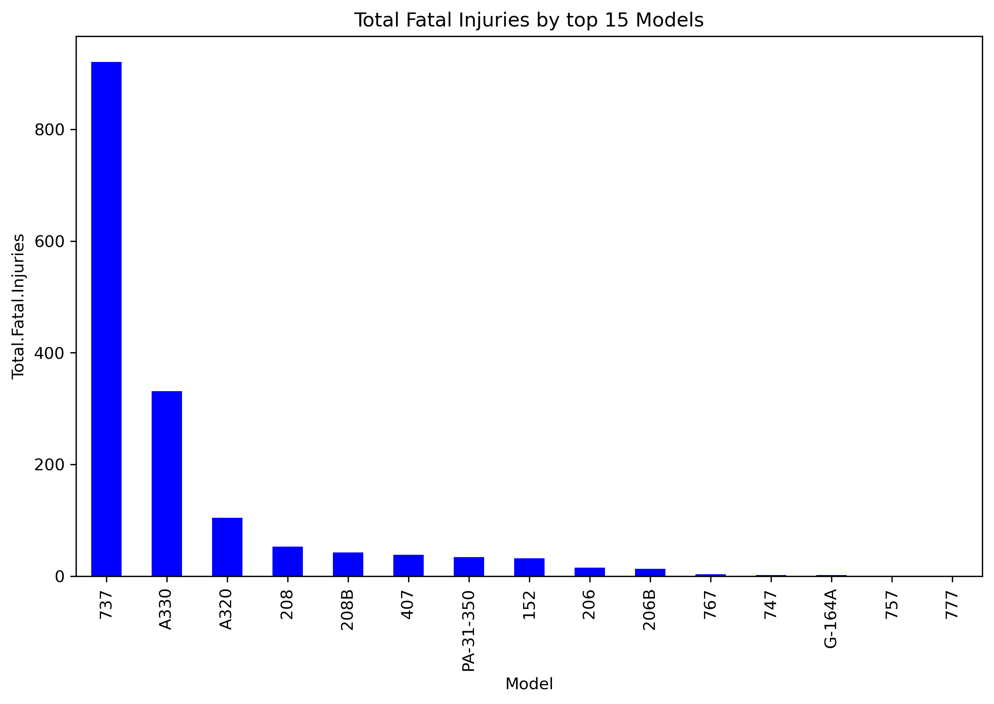
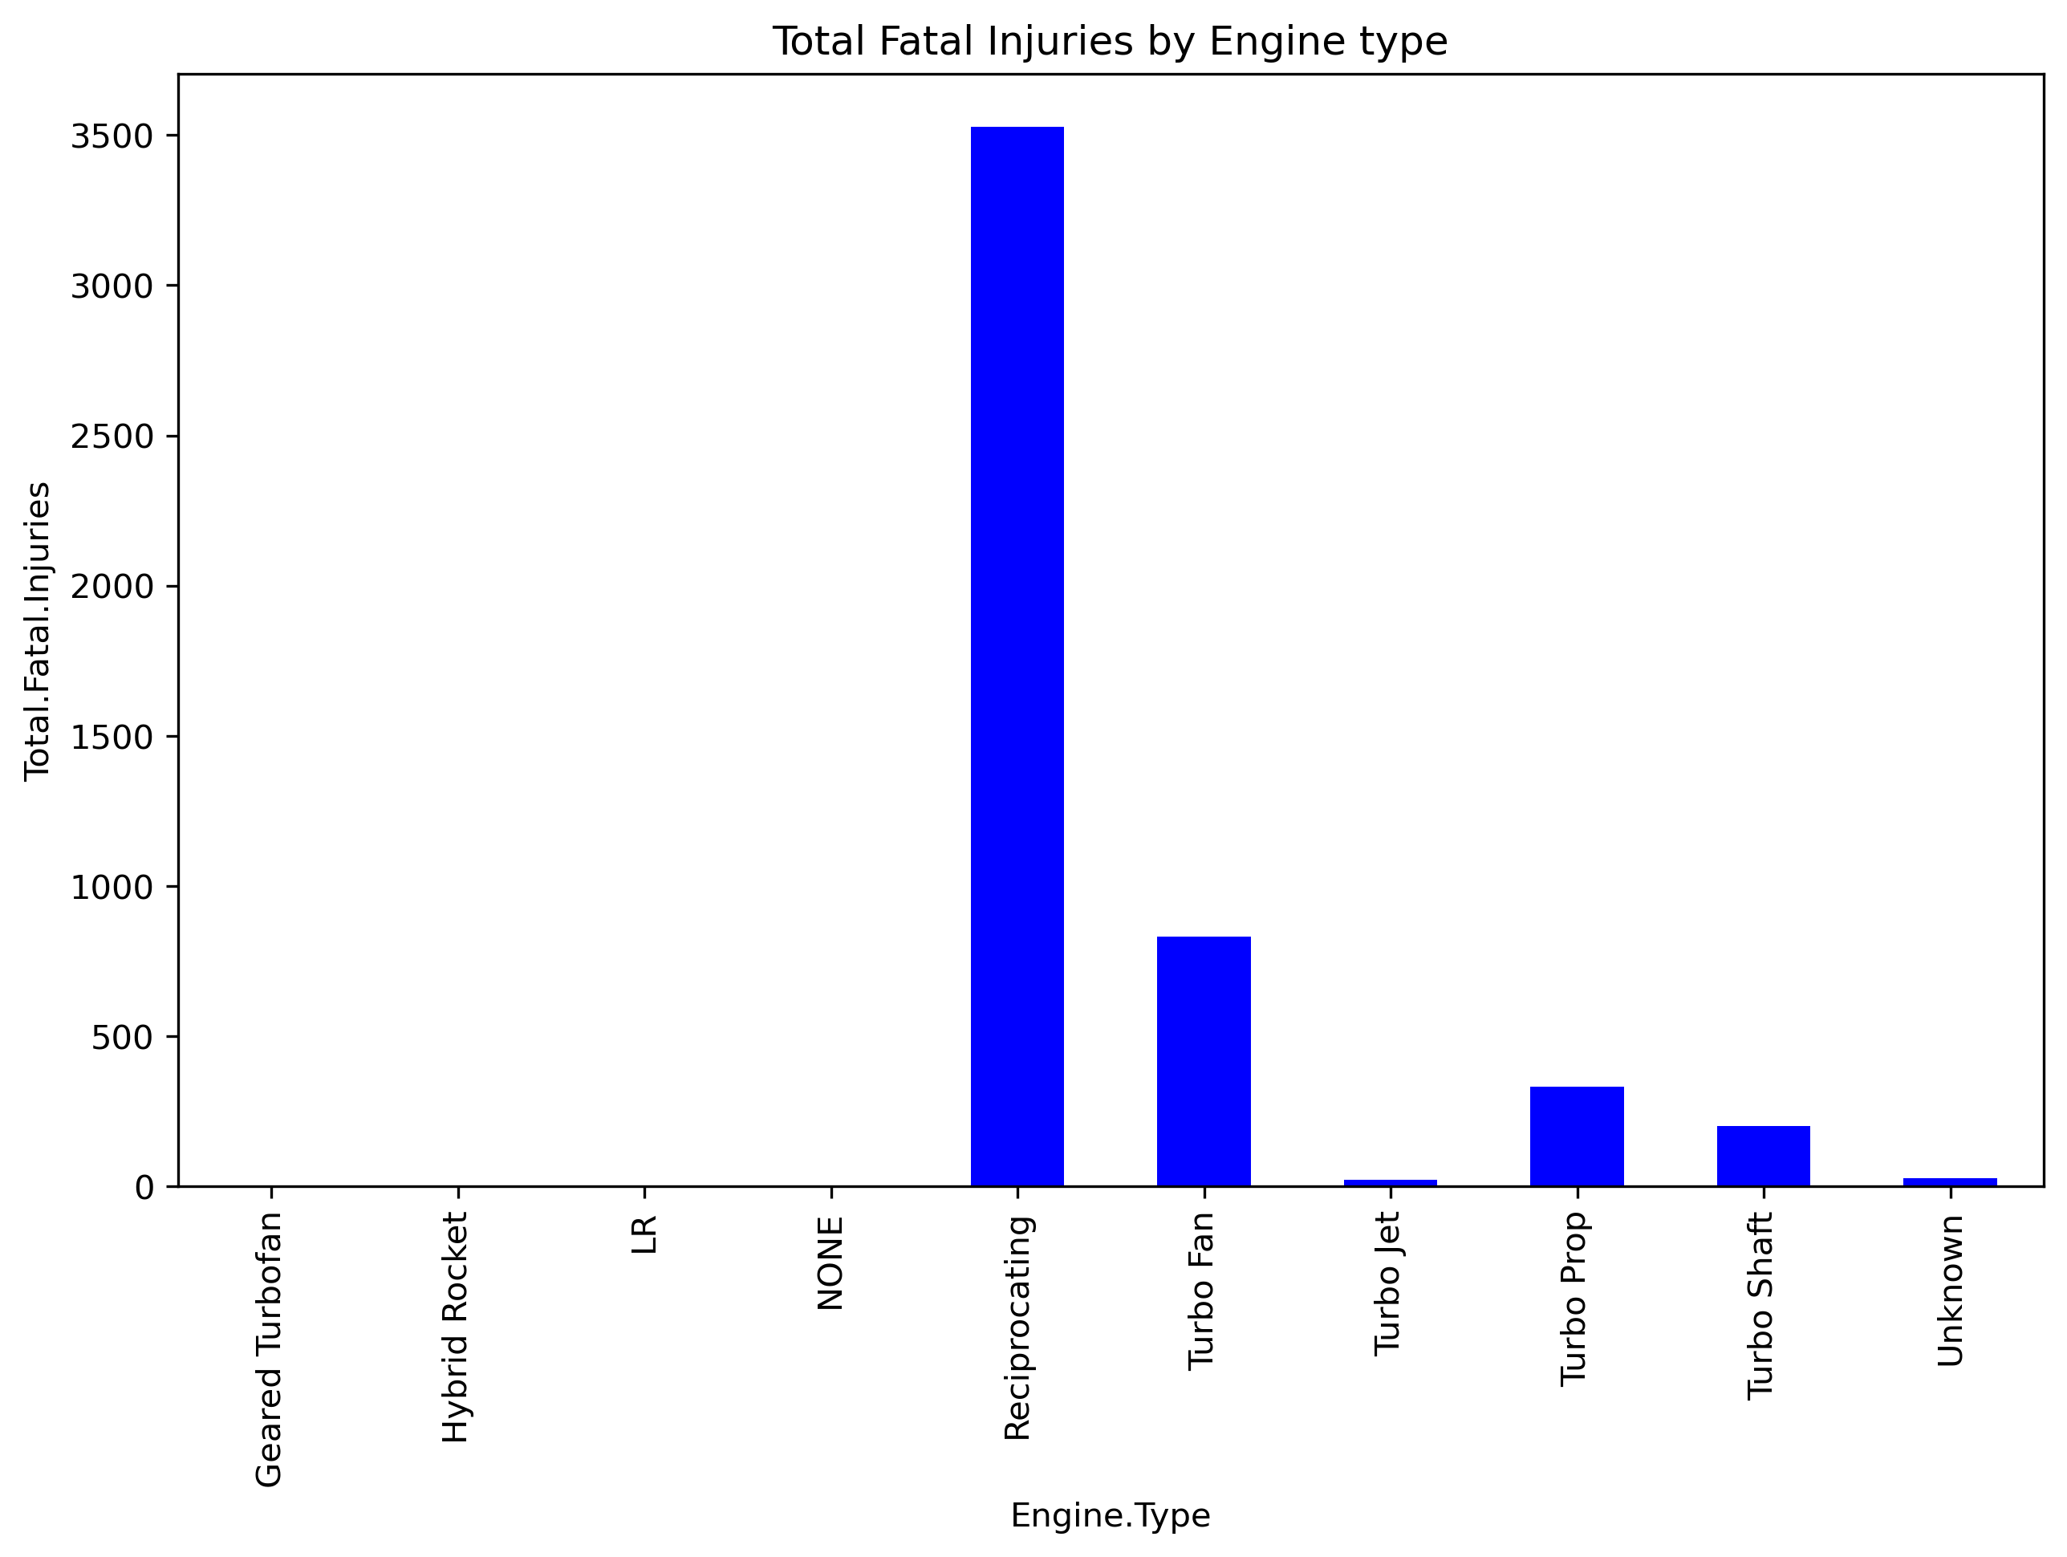
Visualization

Slide 8
Summary
Aircraft model-the Boeing 777 and Boeing 757 stand out as models with low total fatal injuries and strong safety record
Category-Airplanes showed highest number of fatal injuries followed by helicopters. -Balloon,Glinder, and the rest recorded the lowest total fatal injuries among all categories.
Engine type-Reciprocating, turboprop, and turbofans were linked to higher fatal injuries, likely due to their use in high-capacity aircraft. -Simpler engine types (Hybrid, low-risk LR) designs were associated with the lowest fatal injuries.

Slide 9
Recommendations
Aircraft category-helicopter and airplanes had relatively high fatal injury
totals, alternative categories are recommended.
Engine type-Aircraft with low Risk (LR) or simpler engine types recommended
Aircraft model-Boeing 777 and 757 demonstrated strong and safer records with low fatal injuries
Trends over time-fatal injuries peaked in 9180s and declined steadily. Advancement in technology, regulations and training contribute to the improved safety

